Slide 1
Downtown Valdosta Truck Traffic Mitigation Study
Final Study Presentation
Southern Georgia Regional Commission
Dike Ahanotu and Christopher Lindsey
June 21, 2016

Slide 2
Agenda
Review of Alternatives
Presentation of Model Results
Discussion of a Potential Path Forward

Slide 3
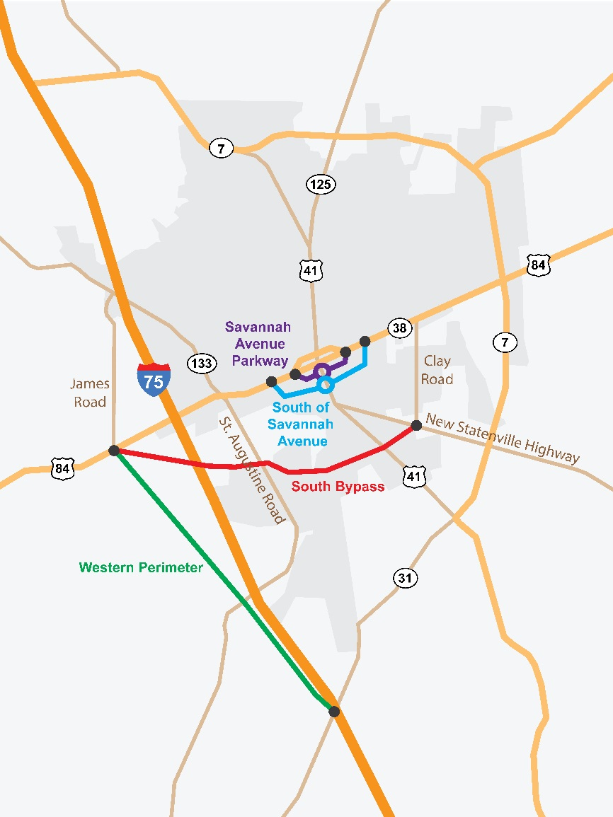
Review of Alternatives
Five alternatives evaluated
  Do Nothing
  Western Perimeter Bypass
  South Bypass
    James Road Route
    St. Augustine Road Route (NEW)
  Savannah Avenue Parkway Bypass
    All Vehicles
    Trucks Only
    Four Lanes
  South of Savannah Avenue Bypass

Slide 4
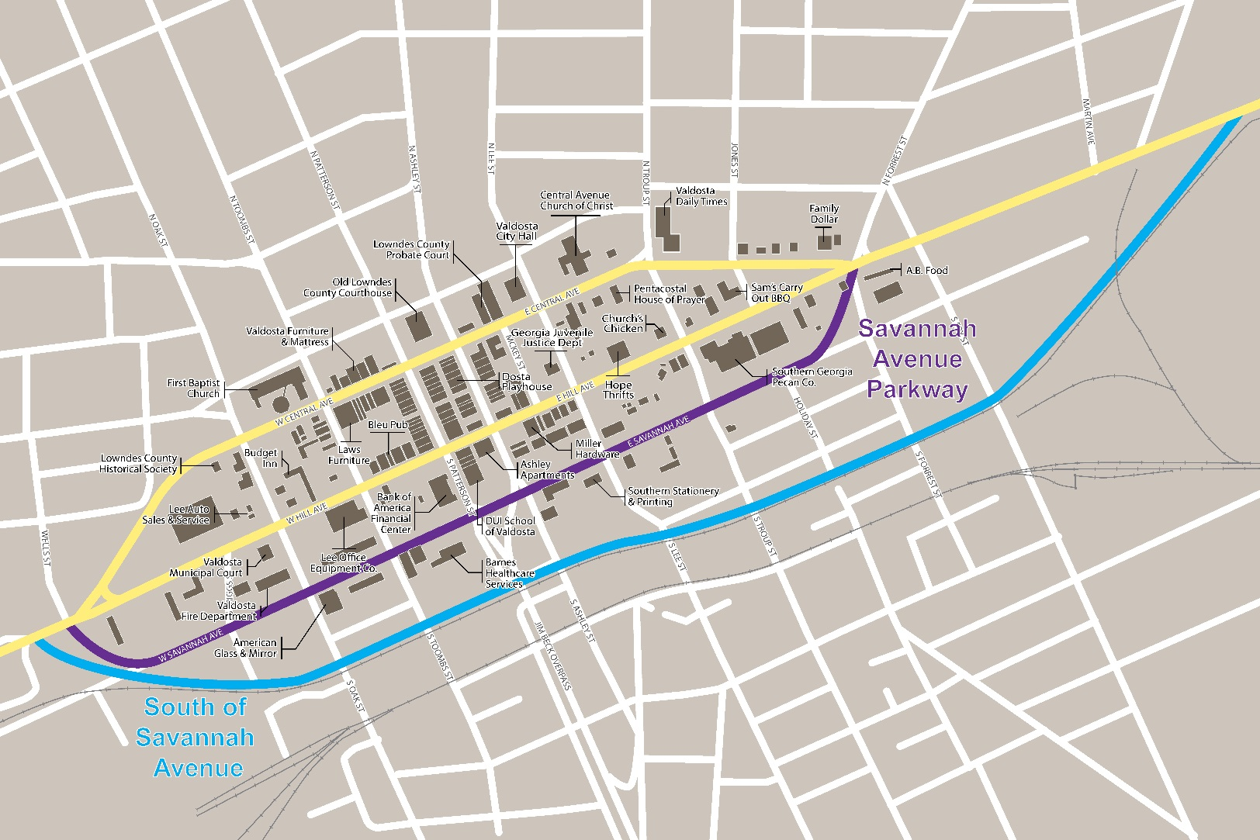
Alternatives Near Downtown

Slide 5
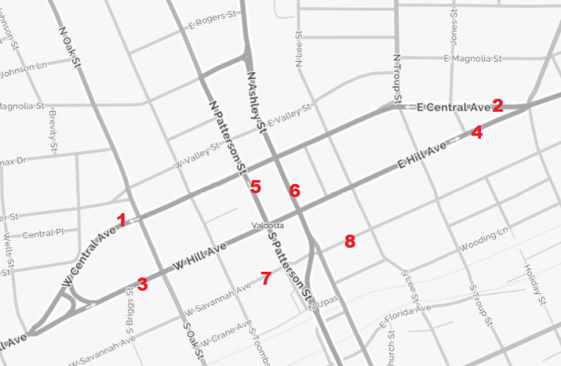

Evaluation of Alternatives
Travel demand model estimated traffic volume changes at 8 locations.
Alternatives evaluated based on:
  Truck traffic diverted away from downtown
  Traffic impacts on passenger vehicles
  Impacts of the alternatives on downtown businesses, residents, and visitors
  Consistency with current long-range plans
  Planning level cost considerations
  Safety implications

Slide 6
Model Results – Truck Traffic
 |  |  | Savannah Avenue Parkway |  |  |  | South Bypass
Location | Daily Truck Volumes (2010) | 2040 Do-Nothing | 2040 All Vehicles | 2040 Trucks Only | 2040 Four Lanes | 2040 South of Savannah Ave. | 2040 James Road Route | 2040 S. A. Road Route
West Central Ave. | 1,200 | 27% | -11% | -68% | -15% | -33% | -100% | -100%
East Central Ave. | 790 | 57% | 11% | -54% | -22% | -20% | -100% | -100%
West Hill Ave. | 1,270 | 14% | -29% | -85% | -62% | -56% | -100% | -100%
East Hill Ave. | 600 | 50% | 2% | -93% | -66% | -65% | -100% | -100%
West Savannah Ave. | 200 | 55% | 850% | 2,670% | 1,310% | -80% | 220% | 325%
East Savannah Ave. | 600 | 32% | 282% | 823% | 450% | -18% | 228% | 235%
The Savannah Avenue Trucks Only alternative removes the most trucks without a truck ban on downtown roads
South of Savannah Alternative removes a significant amount of trucks
Notes:
To some degree, all of the alternatives decrease truck traffic in downtown. The Savannah Avenue and South Bypass alternatives, however, are projected to remove the most trucks from downtown. The new alternative, South Bypass (St. Augustine Road Route) has similar performance as the James Road Route. However, it is projected to increase the amount of truck traffic on Savannah Avenue above the prediction for the James Road Route.

Slide 7
Model Results – Passenger Traffic
 |  |  | Savannah Avenue Parkway |  |  |  | South Bypass
Location | 2010 Daily Pax Vehicle Volumes | 2040 Do-Nothing | 2040 All Vehicles | 2040 Trucks Only | 2040 Four Lanes | 2040 South of Savannah Avenue | 2040 James Road Route | 2040 S. A. Road Route
West Central Ave. | 5,610 | 31% | -2% | 49% | 3% | -13% | 42% | 51%
East Central Ave. | 3,560 | 33% | -1% | 50% | -41% | -32% | 41% | 57%
West Hill Ave. | 5,830 | 23% | -17% | 39% | -34% | -33% | 34% | 44%
East Hill Ave. | 3,030 | 52% | -2% | 79% | -34% | -50% | 64% | 86%
W. Savannah Ave. | 1,350 | 18% | 537% | -100% | 801% | -91% | -19% | 7%
E. Savannah Ave. | 2,890 | 42% | 286% | -100% | 429% | -6% | 0.3% | 10%
Passenger traffic increases substantially with the Savannah Avenue Trucks Only alternative
The four-lane alternatives remove passenger traffic from downtown
Notes:
Many alternatives likewise decrease passenger vehicle traffic in downtown. However, the South Bypass and the trucks-only Savannah Avenue alternative would increase passenger traffic on Central and Hill Avenues. The St. Augustine Route subalternative increases passenger traffic above the prediction for the James Road Route.

Slide 8
Evaluation of Other Impacts
 |  | Savannah Avenue Parkway |  |  |  | South Bypass
Potential Impacts | Do Nothing | All Vehicles | Trucks Only | 4 Lanes | South of Savannah Avenue | James Road Route | S. A. Road Route | Western Perimeter
Impact to Downtown Businesses | ○ |  |  |  |  |  |  | ○
Vehicle Safety | ○ |  |  |  |  |  |  | ○
Pedestrian Safety | ○ |  |  |  |  |  |  | ○
Federal & State Approval |  |  |  |  |  |  |  | 
Impact to EJ Areas | ○ | ○ | ○ | ○ |  |  |  | ○
Right-of-Way Needs | ○ | ○ | ○ |  |  |  |  | 
Consistent with Previous Plans |  | ○ | ○ |  |  |  |  | 
Time/Impact of Construction |  | ○ | ○ |  |  |  |  | 
Wetlands | ○ | ○ | ○ | ○ | ○ |  |  | ○
“” = Very positive impact; “” = Positive impact; “ “ = Negative impact; “ “ = Very negative impact; “○” = Likely minimal impact

Slide 9
Potential Path Forward

Slide 10
Alternative Strategy
Short-term Strategy
  An alternative that can be implemented relatively quickly, at low cost, and offer immediate relief to downtown businesses and residents
    Savannah Avenue alternatives
Long-term Strategy
  An alternative that requires a greater investment of time and financial resources, but may complement other regional goals and be more sustainable
    New alignments
Hybrid Strategy
  Implement a short-term fix while pursuing a longer-term solution

Slide 11
Hybrid Strategy
Implement Savannah Ave. Trucks-Only alternative in the short-term while pursuing the South of Savannah Avenue alternative for the long-term
Benefits
  Offers immediate truck relief for downtown at relatively low cost
  Provides flexibility for managing truck and auto movements in case growth differs from forecast
  Preserves options in case Savannah Avenue Trucks Only alternative is sufficient
Challenges
  Requires higher investment of time and financial resources

Slide 12
Next Steps
Develop recommendations based on community feedback
Confirm path forward with GDOT
Complete final report

Slide 13
Appendix

Slide 14
Modeled Alternatives Description
Do-Nothing – No significant change in downtown roadway
Savannah Ave. Pkwy (All Vehicles) - connect to Wells and Forrest Streets, make 2-way for entire stretch. Increase design speed from 25 mph to 35 mph
Savannah Ave. Pkwy (Trucks-Only) – same as above, but for trucks only
Savannah Ave. Pkwy (4-lanes, all vehicles) – Upgrade to a four-lane state route (new U.S. 84)
South of Savannah Ave. – Build new 4-lane roadway south of Savannah Avenue Parkway with design speed on 45 mph (new U.S. 84).
South Bypass (James Road Route) – 4-lane roadway. Mix of existing and new lanes. Restricts truck traffic from Central Ave. and Hill Ave. (new U.S. 84)
South Bypass (St. Augustine Road Route) – same as above, but uses St. Augustine Road to connect to Hill Ave. as opposed to a new roadway

Slide 15
Summary Results by Alternative
Do-Nothing – Truck and auto volumes on Central and Hill increase substantially
Savannah Ave. Pkwy (All Vehicles) – Holds truck and auto volumes relatively constant
Savannah Ave. Pkwy (Trucks-Only) – Removes most trucks (about 66%) from Central and Hill. Auto volumes on Central and Hill grow substantially
Savannah Ave. Pkwy (4-lanes, all vehicles) – Removes high fraction of trucks from Central and Hill. Decreases autos on Central and Hill
South of Savannah Ave. – Slight improvement over Savannah Ave. Pkwy in terms of autos and trucks removed from Central and Hill
South Bypass (James Road Route) – Removes trucks from Central and Hill. Autos increase substantially
South Bypass (Saint Augustine Road Route) – Removes trucks from Central and Hill. Autos increase more substantially than in the James Road Route alternative, which was noted as important to some stakeholders

Slide 16
Criteria for Selecting a Preferred Alternative
Alternatives were selected based on their ability to alleviate downtown truck traffic and other criteria including:
  Vehicle and Pedestrian Safety
  Impact to Passenger Vehicle Volumes
  Federal and State Approval
  Impacts to Environmental Justice Areas
  Cost to Local Governments
  Environmental Impacts
  Time to Implementation
Based on these criteria, some alternatives are more well-suited for either short- or long-term strategies for managing truck traffic

Slide 17
Short-term Strategy
Implement the Savannah Ave. Parkway Trucks-Only alternative
Benefits
  It can be implemented relatively quickly and at low cost
  Requires only modest infrastructure upgrades
  Minimal environmental and community impacts
  Does not require significant state or federal coordination
Challenges
  Effectiveness of the Trucks-Only alternative strongly depends on enforcement of Savannah Ave. as an exclusive truck facility
  It would also require significant outreach to and cooperation from motor carriers

Slide 18
Long-term Strategy
Implement either of the South Bypass alternatives
Benefits
  Potential to divert U.S. 84 to one of the South Bypass routes and implement truck restrictions on Central and Hill Avenues
  Potential to convert Central and Hill Avenues to two-way streets, improving the pedestrian experience downtown
  Complements broader regional initiatives such as linking industrial clusters and spurring freight-related economic development
Challenges
  High cost and time-intensive
  Multiple at-grade rail crossings would likely have to be separated for state and federal officials to consider re-routing U.S. 84
  Local government to take on cost of maintaining and operating Central and Hill Avenues

