Slide 1
Downtown Valdosta Truck Traffic Mitigation Study
Southern Georgia Regional Commission
Dike Ahanotu and Christopher Lindsey
May 10, 2016

Slide 2
Overview and Approach
Primary Project Goal – Develop traffic improvements for local and through truck traffic along U.S. 84
Task Structure
  Task 1 - Assemble existing data on truck movements in downtown Valdosta
  Task 2 - Collect new data on truck movements, primarily through using truck-following techniques
  Task 3 – Stakeholder outreach
  Task 4 – Alternatives evaluation

Slide 3
New Data – Truck Travel Patterns

Slide 4
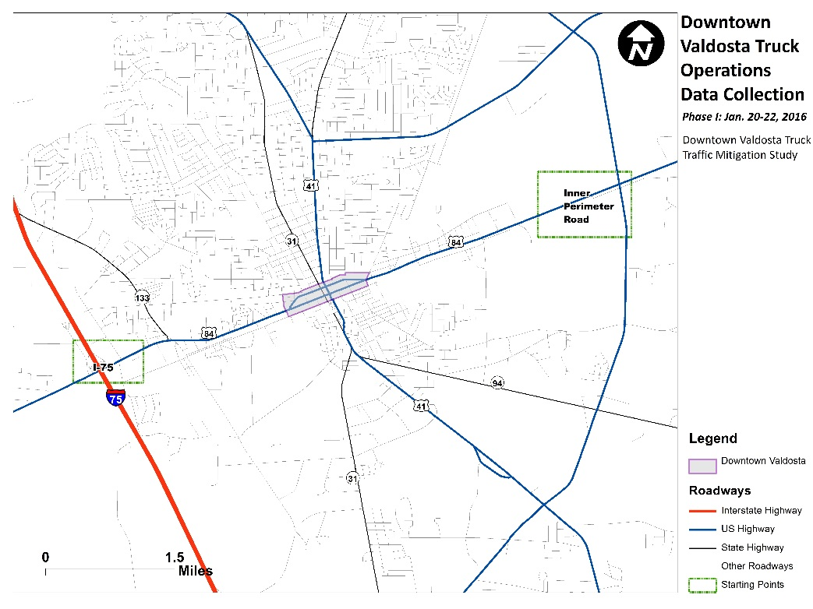

Truck Following Data Collection – Phase 1
Trucks were followed from two locations:
  U.S. 84 and I-75
  U.S. 84 and Inner Perimeter Road
Goals were to:
  Estimate percent of through trucks
  Identify local destinations for U.S. 84 trucks

Slide 5
Data Collection Results - Phase 1
Only 2% of trucks followed stopped in downtown
Destinations to the south were much more common than destinations to the north
 | I-75 Starting Point |  | Inner Perimeter Road Starting Point
Destination Region | No. of Trucks | Percent of Total | No. of Trucks | Percent of Total
Through Downtown Core and Entire Valdosta Region | 15 | 42% | 18 | 62%
Through Downtown Core – stopping south of downtown | 7 | 19% | 8 | 28%
Through Downtown Core – stopping north of downtown | 3 | 8% | 0 | 0%
Through Downtown Core – stopping east of downtown* | 9 | 25% | 0 | 0%
Through Downtown Core – stopping west of downtown* | 1 | 3% | 3 | 10%
Destination Within Downtown Core | 1 | 3% | 0 | 0%
Total | 36 | 100% | 29 | 100%
*A small portion of trucks did not go through downtown at all

Slide 6
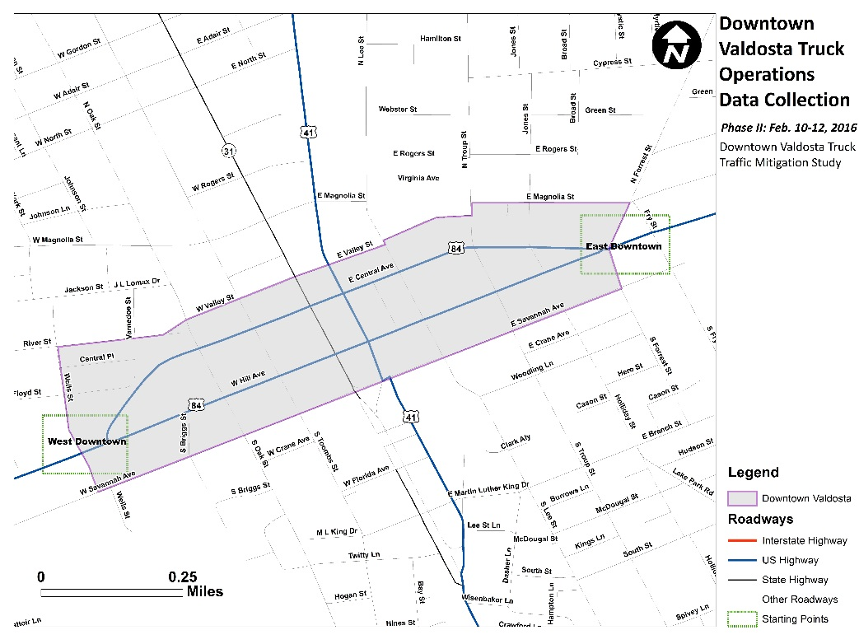
Truck Following Data Collection – Phase 2
Trucks were followed from just west and east of downtown core
Goal was to collect similar information as Phase 1 on a larger sample of trucks

Slide 7
Data Collection Results – Phase 2
2% of trucks followed stopped in downtown
Destinations to the south were common for trucks followed from the east of downtown
 | West Downtown Starting Point |  | East Downtown Starting Point
Destination Region | No. of Trucks | Percent of Total | No. of Trucks | Percent of Total
Through Downtown Core – exiting to the east | 105 | 91% | 0 | 0%
Through Downtown Core – exiting to the west | 0 | 0% | 82 | 74%
Through Downtown Core – exiting to the south | 4 | 3% | 24 | 22%
Through Downtown Core – exiting to the north | 2 | 2% | 3 | 3%
Destination Within Downtown Core | 4 | 3% | 2 | 2%
Total | 115 | 100% | 111 | 100%
Notes:
The vast majority of trucks are making through trips – nearly 96% in both directions. Intuitively, Log trucks and Hoppers never stop downtown. Other truck types rarely stop downtown, though Vans and Straight/ Single Unit trucks may be delivering to downtown businesses. Besides US 84, Lee Street and Oak Street are most often used by trucks with local deliveries

Slide 8
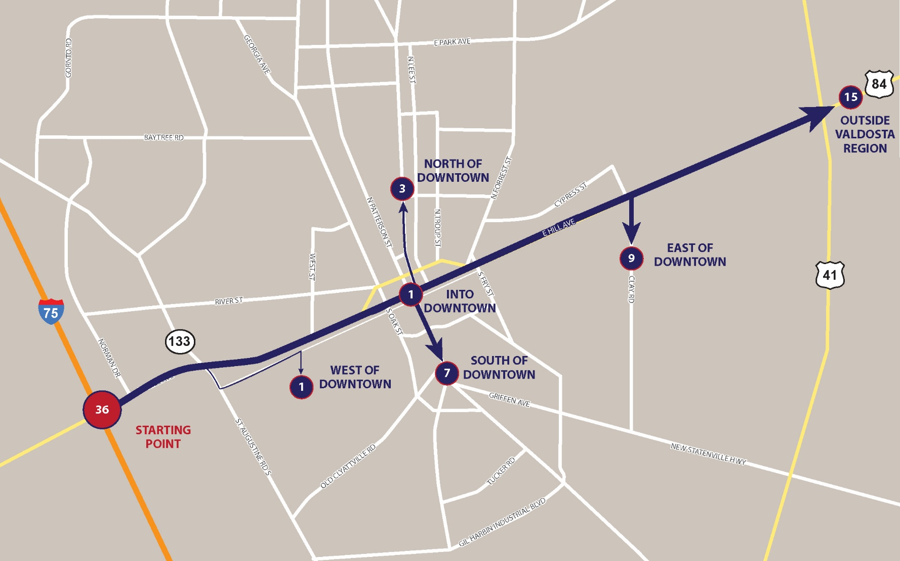
Truck Travel Paths

Slide 9
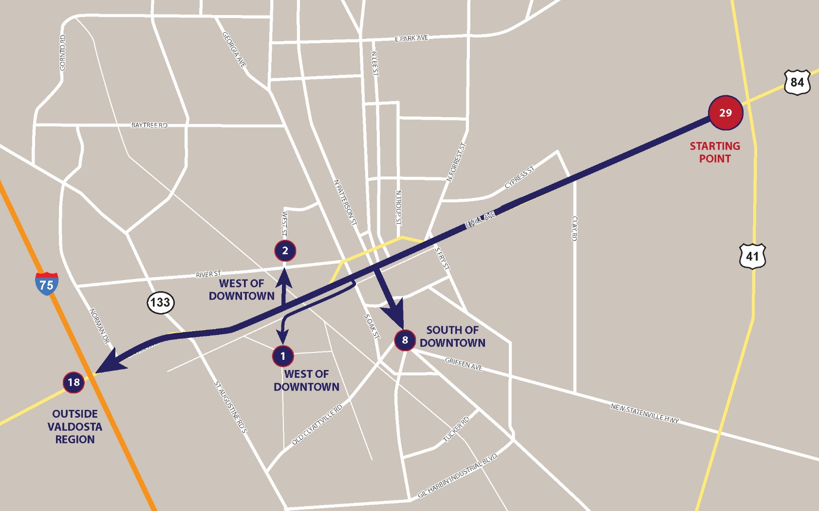
Truck Travel Paths

Slide 10
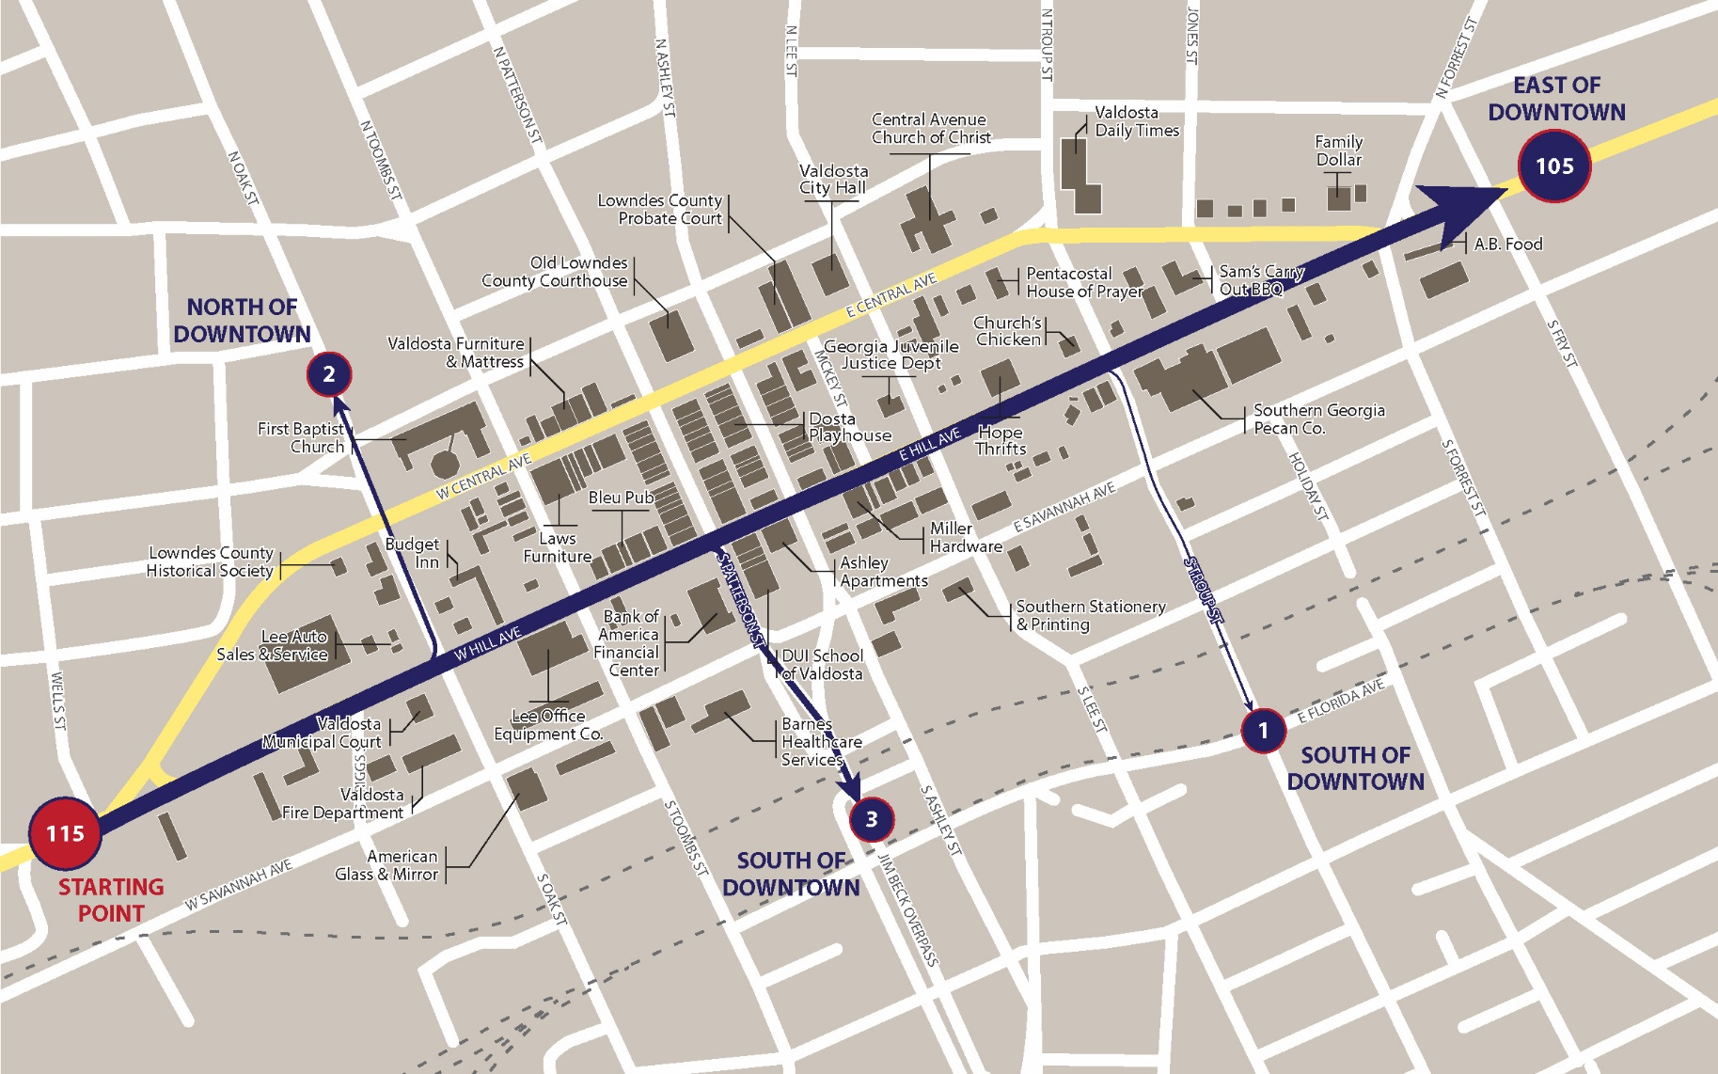
Truck Travel Paths

Slide 11
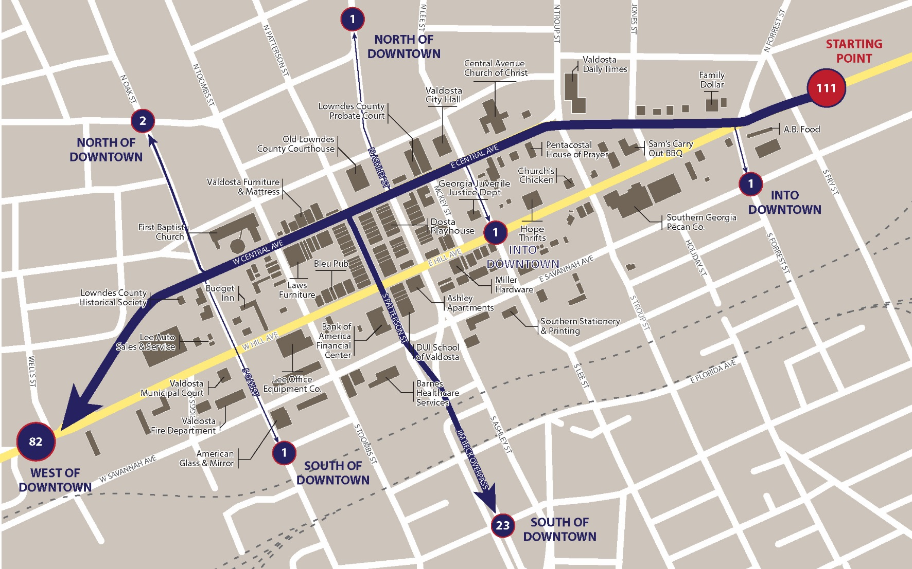
Truck Travel Paths

Slide 12
Stakeholder Outreach

Slide 13
Stakeholder Interviews
Stakeholder Interviews
  Public Sector - City of Valdosta, Lowndes County, Valdosta Main Street, Valdosta Development Authority, GDOT
  Private Sector - IDP Housing, Southeastern Freight Lines, Archer Daniels Midland (ADM), ASA Engineering, Prime Properties, Outsource Logistics, Valdosta-Lowndes Chamber of Commerce
Quality of Life Issues Confirmed
  Truck volumes and speeds through downtown create negative impacts related to noise, vibrations, and ability to hold events downtown
  Pedestrian mobility negatively impacted and sidewalks are often damaged
  Mixed opinions on importance of passenger vehicle traffic for downtown businesses
Freight operations
  Motor carriers prefer to avoid downtown, but there are no better alternatives
  Bypass alternatives should limit turns, avoid rail crossings and have simple, straightforward routing and signage

Slide 14
Evaluating Alternatives

Slide 15
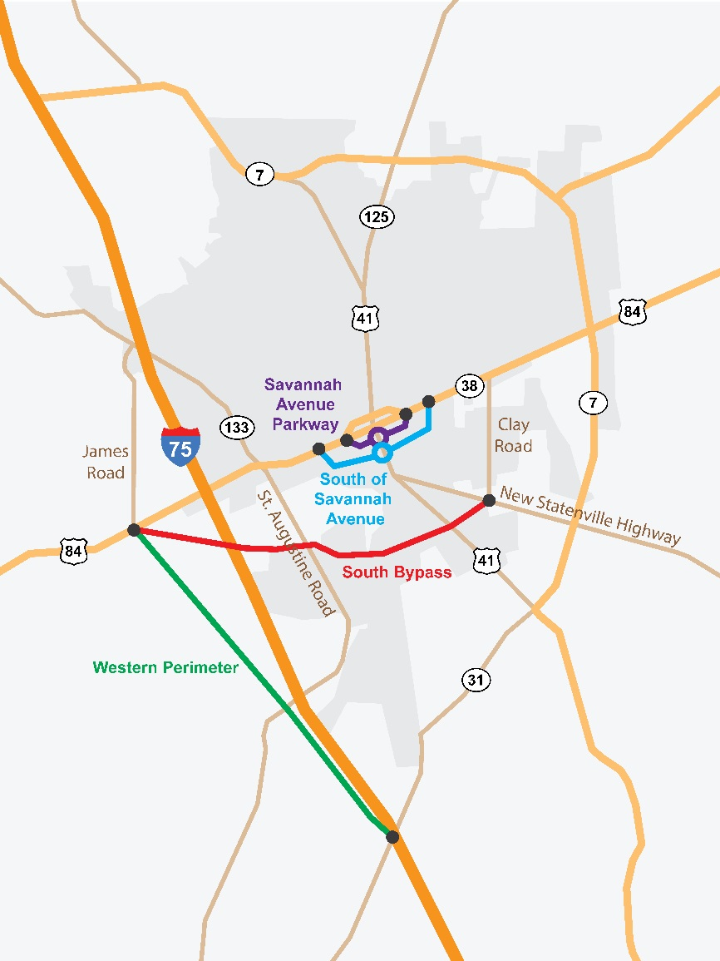
Description of Alternatives
There are 5 primary alternatives for alleviating downtown truck traffic
  Do Nothing
  Western Perimeter Bypass
  South Bypass
  Savannah Avenue Parkway Bypass
  South of Savannah Avenue Bypass

Slide 16
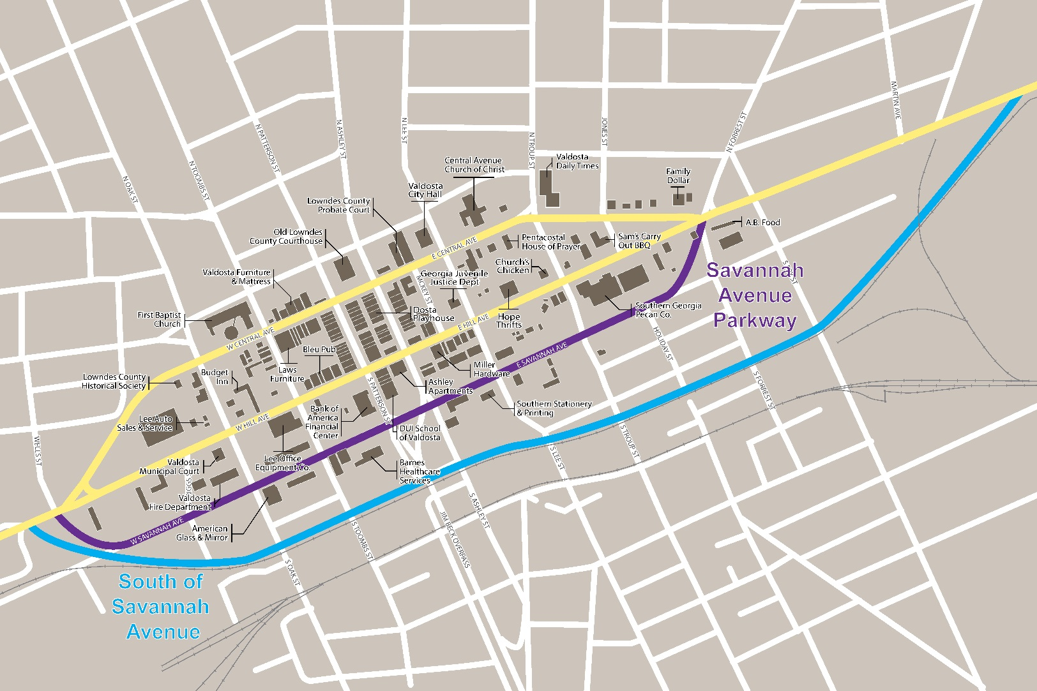
Description of Alternatives Near Downtown

Slide 17
Description of Modeled Alternatives
Do-Nothing – No significant change in downtown roadway
Savannah Ave. Pkwy (All Vehicles) - connect to Wells and Forrest Streets, make 2-way for entire stretch. Increase design speed from 25 mph to 35 mph
Savannah Ave. Pkwy (Trucks-Only) – same as above, but for trucks only
Savannah Ave. Pkwy (4-lanes, all vehicles) – Upgrade to a four-lane state route (new U.S. 84)
South of Savannah Ave. – Build new 4-lane roadway south of Savannah Avenue Parkway with design speed on 45 mph (new U.S. 84).
South Bypass – 4-lane roadway. Mix of existing and new lanes. Restricts truck traffic from Central Ave. and Hill Ave. (new U.S. 84)

Slide 18
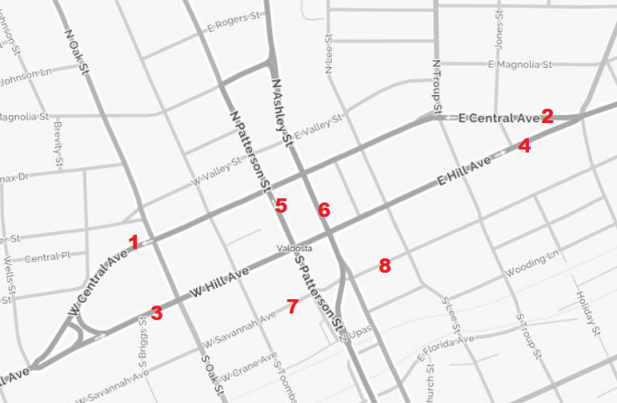
Modeling the Diversion of Truck Traffic
Travel demand model used to measure the change in traffic volumes at 8 downtown locations.
Alternatives evaluated based on:
  Truck traffic diverted away from downtown
  Impacts on downtown passenger vehicle traffic
  Impacts of the alternatives on downtown businesses, residents, and visitors
  Consistency with current long-range plans
  High-level cost considerations
  Safety implications

Slide 19
Truck Volume Model Results
Location | Daily Truck Volumes (2010) | 2040 Do-Nothing | 2040 Savannah Ave. Pkwy. (All Vehicles) | 2040 Savannah Ave. Pkwy. (Trucks Only) | 2040 Savannah Avenue Parkway (4 Lanes) | 2040 South of Savannah Ave. | 2040 South Bypass
West Central Ave. | 1,200 | 27% | -11% | -68% | -15% | -33% | -100%
East Central Ave. | 790 | 57% | 11% | -54% | -22% | -20% | -100%
West Hill Ave. | 1,270 | 14% | -29% | -85% | -62% | -56% | -100%
East Hill Ave. | 600 | 50% | 2% | -93% | -66% | -65% | -100%
South Patterson St. | 1,170 | -7% | -33% | -45% | -40% | -21% | -16%
South Ashley St. | 940 | 3% | -11% | -24% | -26% | -14% | 67%
West Savannah Ave. | 200 | 55% | 850% | 2,670% | 1,310% | -80% | 220%
East Savannah Ave. | 600 | 32% | 282% | 823% | 450% | -18% | 228%
Notes:
To some degree, all of the alternatives decrease truck traffic in downtown. The Savannah Avenue and South Bypass alternatives, however, are projected to remove the most trucks from downtown.

Slide 20
Passenger Volume Model Results
Location | 2010 Daily Pax Vehicle Volumes | 2040 Do-Nothing | 2040 Savannah Ave. Pkwy (All Vehicles) | 2040 Savannah Ave. Pkwy (Trucks Only) | 2040 Savannah Ave. Pkwy (4 Lanes) | 2040 South of Savannah Avenue | 2040 South Bypass
West Central Ave. | 5,610 | 31% | -2% | 49% | 3% | -13% | 42%
East Central Ave. | 3,560 | 33% | -1% | 50% | -41% | -32% | 41%
West Hill Ave. | 5,830 | 23% | -17% | 39% | -34% | -33% | 34%
East Hill Ave. | 3,030 | 52% | -2% | 79% | -34% | -50% | 64%
South Patterson St. | 6,780 | 15% | -7% | 4% | 7% | 4% | 17%
South Ashley St. | 5,610 | 24% | 8% | 22% | 2% | 6% | 9%
West Savannah Ave. | 1,350 | 18% | 537% | -100% | 801% | -91% | -19%
East Savannah Ave. | 2,890 | 42% | 286% | -100% | 429% | -6% | 0%
Notes:
Many alternatives likewise decrease passenger vehicle traffic in downtown. However, the South Bypass and the trucks-only Savannah Avenue alternative would increase passenger traffic.

Slide 21
Evaluation of Other Impacts
Potential Impacts | Do Nothing | Savannah Ave. Parkway (All Vehicles) | Savannah Ave. Parkway (Trucks Only) | Savannah Ave. Parkway (4 Lanes) | South of Savannah Avenue | South Bypass
Impact to Downtown Businesses | ○ |  |  |  | ○ | 
Vehicle Safety | ○ |  |  |  |  | 
Pedestrian Safety | ○ |  |  |  |  | 
Federal & State Approval |  |  |  |  |  | 
Impact to EJ Areas | ○ | ○ | ○ | ○ |  | 
Right-of-Way Needs | ○ | ○ | ○ |  |  | 
Consistent with Previous Plans |  | ○ | ○ |  |  | 
Time/Impact of Construction |  | ○ | ○ |  |  | 
Wetlands | ○ | ○ | ○ | ○ |  | 

Likely positive impact

Likely negative impact
○
Likely minimal impact

Slide 22
Next Steps
Refine evaluation of alternatives based on feedback
Develop set of recommendations in consultation with the MPO
Develop final report
Project end date – June 30th

